Slide 1

REAL OR FAKE NEWS ANALYSIS

Slide 2
Group Members
Stephy John
Maddula Venkateswara Reddy
Pramod Kumar
Samir Ghul
Krishna Chaithanya Gangula
Syed Uzzam Ahmed
Mentor Name: Karthik Muskula
Coordinator Name: Pallavi B

Slide 3
Contents :
Problem Statement
Proposed Solution
Data Summary
Exploratory Data Analysis
Model Building
Model Evaluation
Deployment
Challenges

Slide 4
Problem Statement
The primary challenge lies in accurately classifying fake and real news from a dataset of approximately 40,000 articles. This includes handling diverse writing styles, varying lengths of articles, and potential overlaps in language features between fake and real news.
Proposed Solution
Use exploratory data analysis (EDA) techniques to identify distinguishing patterns in fake and real news, supported by visualizations like histograms and density plots. Train robust classification models using n-gram analysis to enhance language understanding.

Slide 5
Data Summary
Fake News Dataset:
Size: Contains approximately 4,209 entries with irregularities in some rows.
Columns: Includes fields like title, text, subject, and date.
Sample Content: Articles categorized under topics like "politics" with detailed texts and publication dates.
Data Quality: Issues such as inconsistent fields across rows, possibly due to misaligned formatting or additional separators.
Real News Dataset:
Size: Contains approximately 7,764 entries, also with some parsing issues.
Columns: Similar fields as the Fake dataset (title, text, subject, and date).
Sample Content: Articles include detailed reporting, primarily under the "politics" category.
Data Quality: Exhibits irregularities similar to the Fake dataset, such as unexpected field counts.

Slide 6
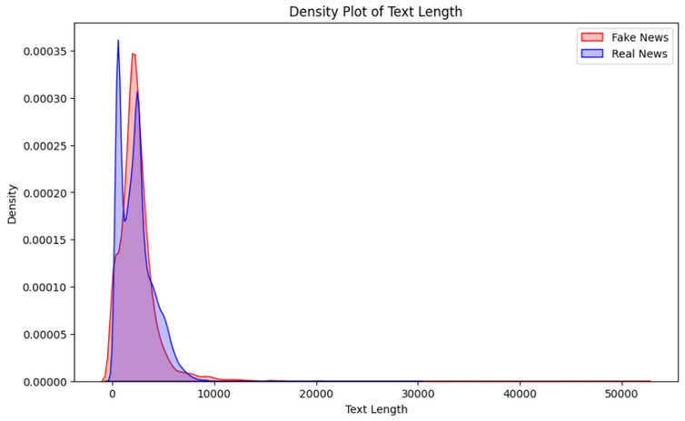
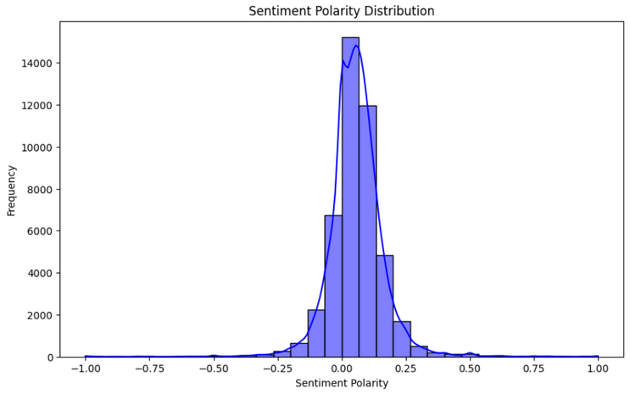
Exploratory Data Analysis(EDA)
Fake news articles tend to have slightly shorter text lengths compared to real news articles, with most texts concentrated within a similar range. However, the distribution tails show a small overlap, implying that text length alone may not be a decisive feature.
The sentiment distribution is centered around neutral polarity for both fake and real news articles, with a slight skew toward positive sentiment. This indicates that sentiment analysis might provide subtle differences in text tone between the two categories.

Slide 7
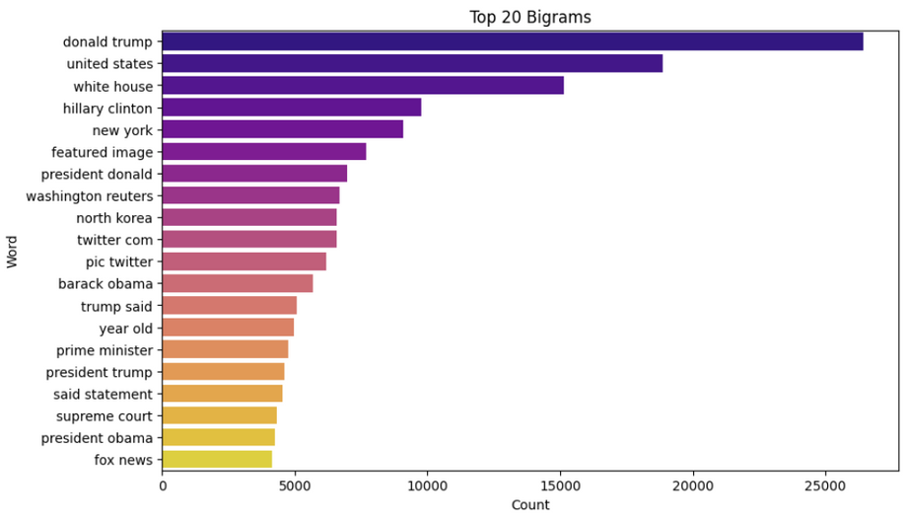
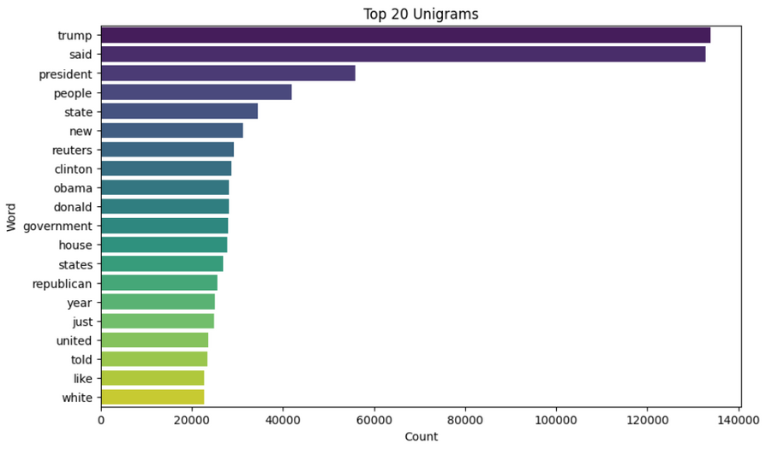
Exploratory Data Analysis(EDA)
The unigram analysis shows the most frequent words across both datasets. "Trump" and "said" are overwhelmingly dominant, indicating their central role in news narratives, particularly regarding political discussions. Other words like "president," "people," and "state" underline the focus on leadership, public opinions, and government.
The most common word pairs in the dataset include political and geographical terms such as "Donald Trump," "United States," and "White House," indicating a focus on political content. This suggests that these terms are significant for distinguishing between fake and real news.

Slide 8
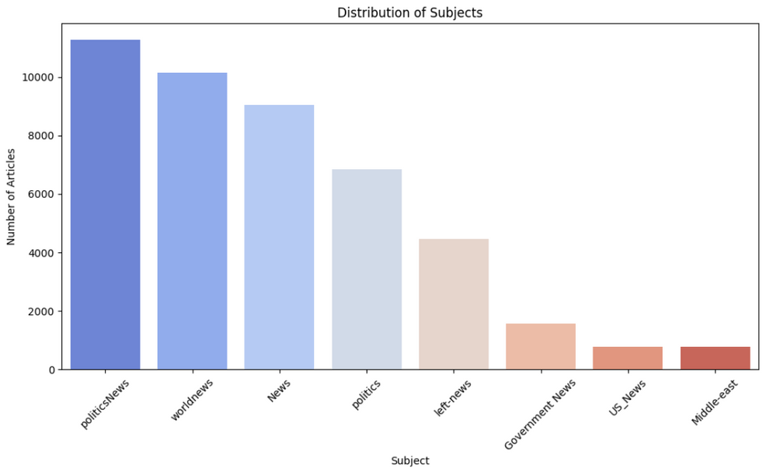
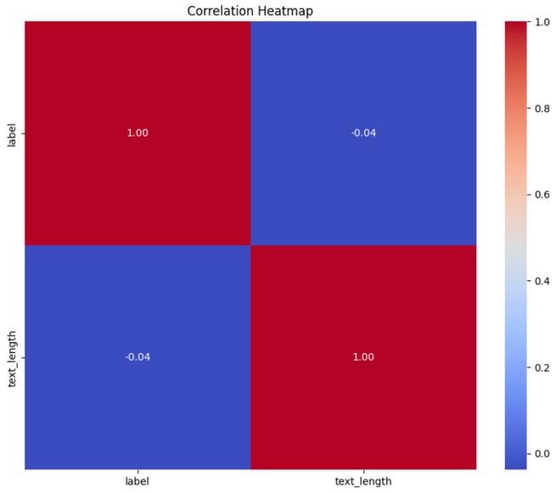
Exploratory Data Analysis(EDA)
The correlation heatmap shows that there is no significant correlation between the labels (likely fake vs. real news) and the text length, with the values near zero indicating a weak or no linear relationship.
The distribution plot indicates that "politicsNews," "worldNews," and "News" are the most frequent categories of articles, whereas "US_News" and "Middle-east" are among the least frequent.

Slide 9
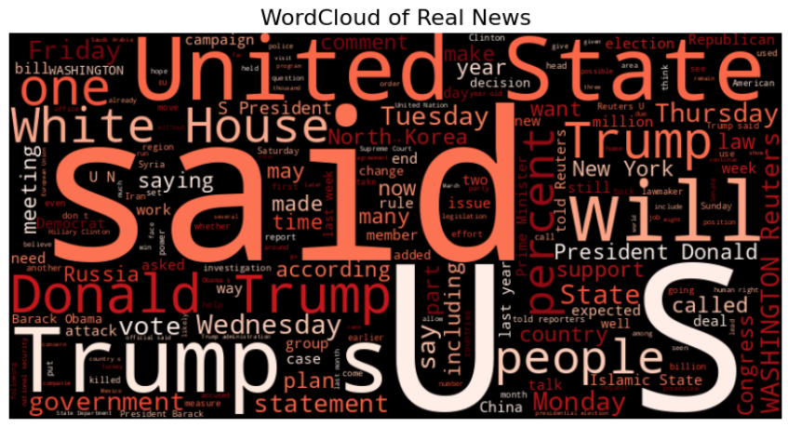

Exploratory Data Analysis(EDA)
The word cloud for real news shows frequent usage of terms like "said," "United States," "Trump," and "White House." The focus here reflects a more formal, structured style typical of journalistic writing, with an emphasis on government, political events, and international affairs. Words like "law," "Congress," and "meeting" reinforce the factual and professional tone of real news reporting.
This word cloud highlights terms like "people," "said," "Trump," and "one" as dominant. This suggests a tendency for fake news to focus on individuals and subjective opinions, often amplifying emotional or exaggerated narratives. Words such as "fact," "country," and "image" also appear prominently, reflecting the attempts of fake news to mimic factual reporting while framing polarizing topics.

Slide 10
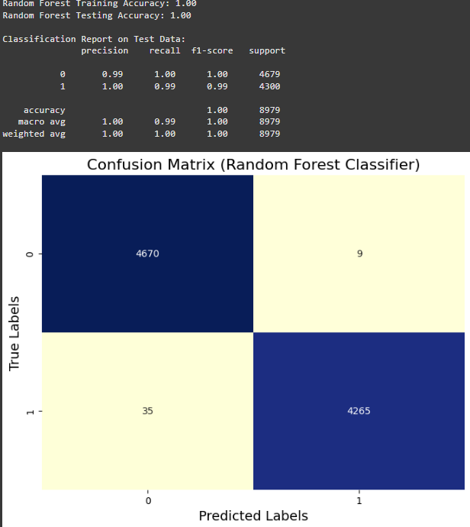
Model Building
Random Forest Classifier
The Random Forest model achieved perfect training accuracy of 1.00 and testing accuracy of 1.00.
Precision, recall, and F1-score are also 1.00, signifying an ideal classification with no compromise.
The confusion matrix shows 4670 true negatives and 4265 true positives.
There are only 9 false positives and 35 false negatives, demonstrating minimal errors.
Random Forest is one of the best-performing model, showing high generalization and robustness in predictions.

Slide 11
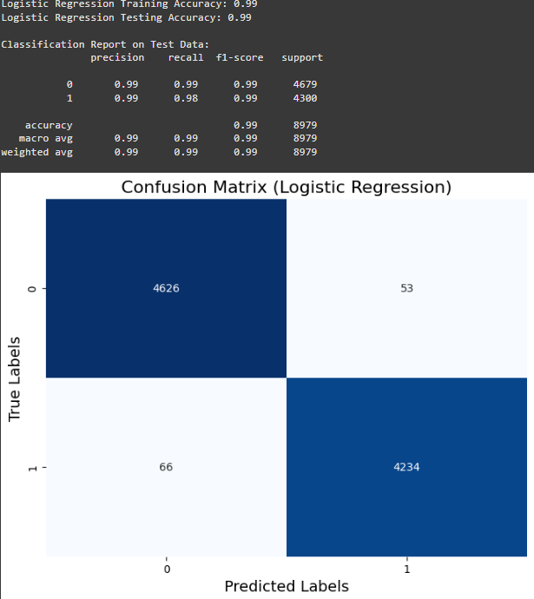
Model Building
Logistic Regression
The Logistic Regression model achieved both training and testing accuracy of 0.99.
The precision, recall, and F1-score for both classes are near 0.99, indicating excellent performance in identifying both classes.
The confusion matrix shows 4626 true negatives (class 0 correctly identified) and 4234 true positives (class 1 correctly identified).
There are 53 false positives (class 0 incorrectly predicted as class 1) and 66 false negatives (class 1 incorrectly predicted as class 0).
The model demonstrates a balance between precision and recall, which is crucial for many classification tasks.

Slide 12
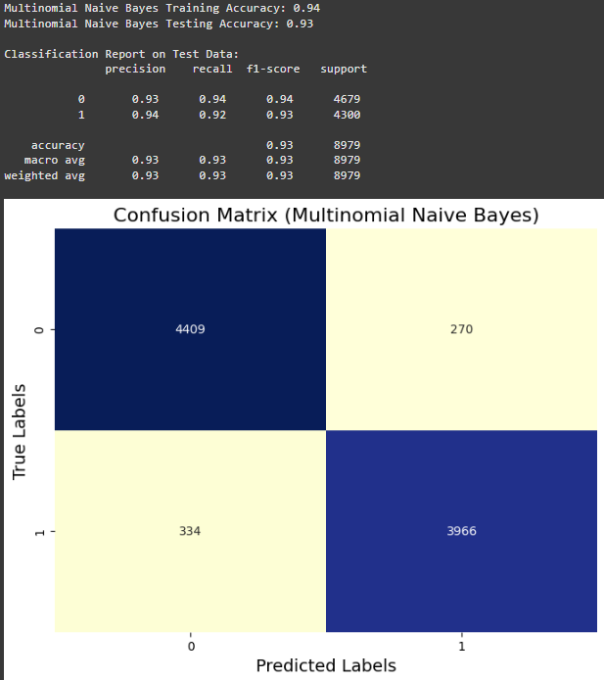
Model Building
Multinomial Naive Bayes
The Multinomial Naive Bayes model achieved training and testing accuracy of 0.94 and 0.93, respectively.
Precision, recall, and F1-score are slightly lower than Logistic Regression, ranging from 0.92 to 0.94.
The confusion matrix indicates 4409 true negatives and 3966 true positives.
However, the model has 270 false positives and 334 false negatives, showing more misclassifications compared to Logistic Regression.
This model is generally suitable for text classification problems but shows reduced effectiveness in this context compared to other methods.

Slide 13
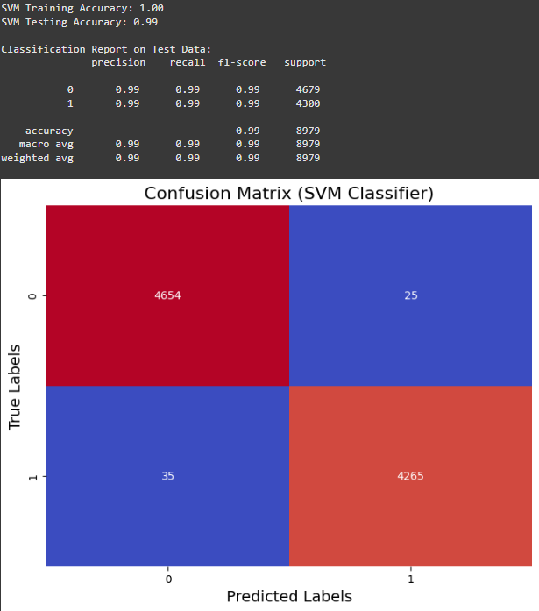
Model Building
SVM Classifier
The SVM classifier achieved 1.00 training accuracy and 0.99 testing accuracy, demonstrating strong generalization.
The precision, recall, and F1-score for both classes are 0.99, indicating excellent performance.
The confusion matrix shows 4654 true negatives and 4265 true positives, accurately identifying most instances.
There are 25 false positives and 35 false negatives, representing minimal misclassifications.
Overall, the SVM classifier is highly effective with a good balance of precision and recall.

Slide 14
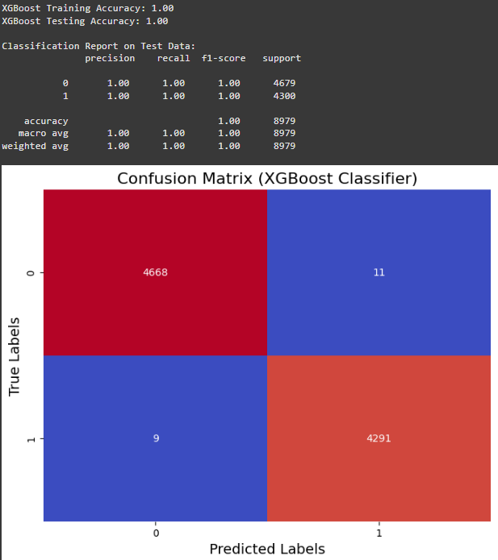
Model Building
XGBoost Classifier
The XGBoost model achieved both training and testing accuracy of 1.00, indicating exceptional performance with no apparent overfitting.
Precision, recall, and F1-scores for both classes are perfect at 1.00, signifying flawless predictions.
The confusion matrix reveals 4668 true negatives and 4291 true positives, with almost no errors.
There are only 11 false positives and 9 false negatives, demonstrating near-perfect classification.
XGBoost outperforms other models by achieving the highest accuracy and minimal misclassification errors.

Slide 15
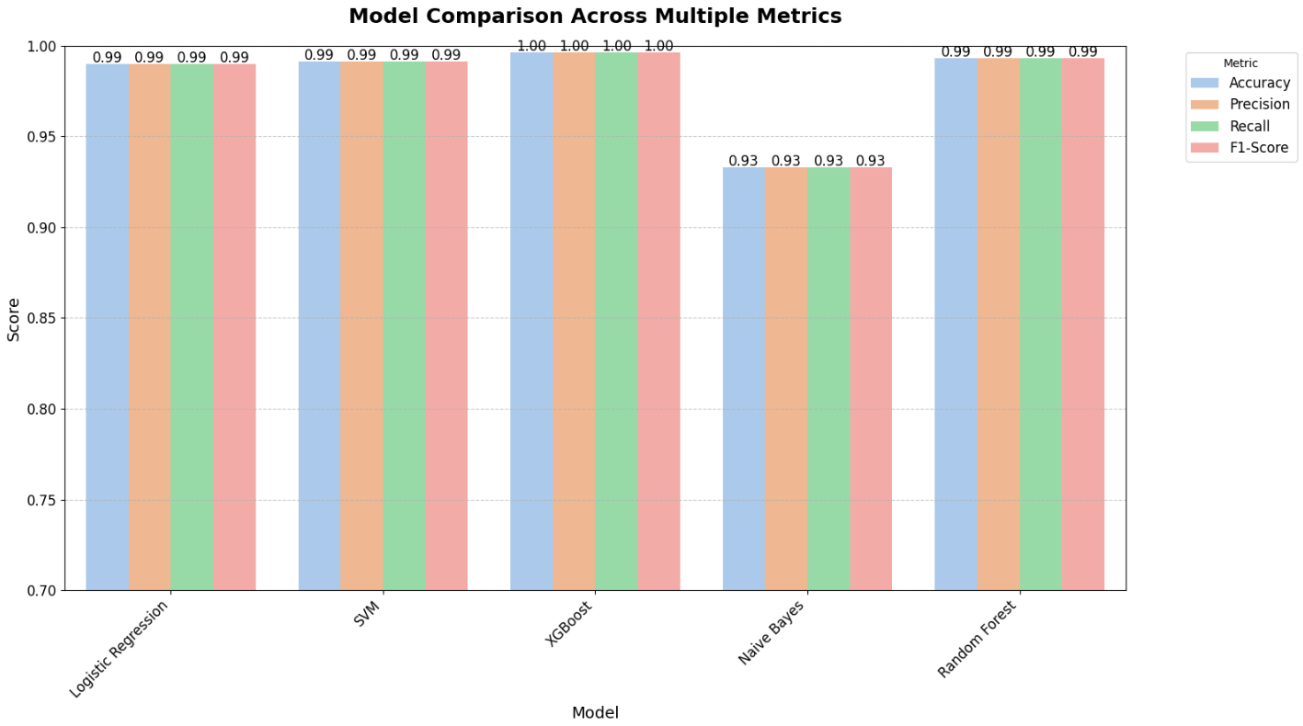
Model Evaluation
Based on this model comparison graph we decided to go with XGBoost Classifier

Slide 16

Deployment

Slide 17

Deployment

Slide 18
Deployment
The application has a text box feature where users can input a news article.
“Classify” button performs the classification.
The result section displays whether the article is classified as “Fake News” or “Real News”.
The design is clean and minimal, focusing on functionality and ease of use.

Slide 19
Challenges
Data Challenges
Dataset Integration: Combining the two datasets (real and fake news) for analysis without introducing errors or biases.
Text Preprocessing: Handling noisy data such as typos, irrelevant content, or incomplete articles.
Exploratory Data Analysis
Insights Extraction: Generating meaningful insights through charts like histograms, density plots, and pie charts.
High Dimensionality: Reducing dimensionality while preserving essential information for analysis and visualization.
Model Development
Algorithm Selection: Choosing between different models for optimal performance.
Overfitting Risk: Preventing the model from performing well on the training set but poorly on unseen data.
Performance Metrics: Selecting appropriate evaluation metrics (e.g., accuracy, F1-score, ROC-AUC) to measure success.

Slide 20
Challenges
Deployment Challenges
User Interface: Building an intuitive interface for users to input news articles and view results effectively.
Scalability: Ensuring the deployment handles a large number of requests efficiently in real-time applications.

Slide 21
Thank you

